Slide 1
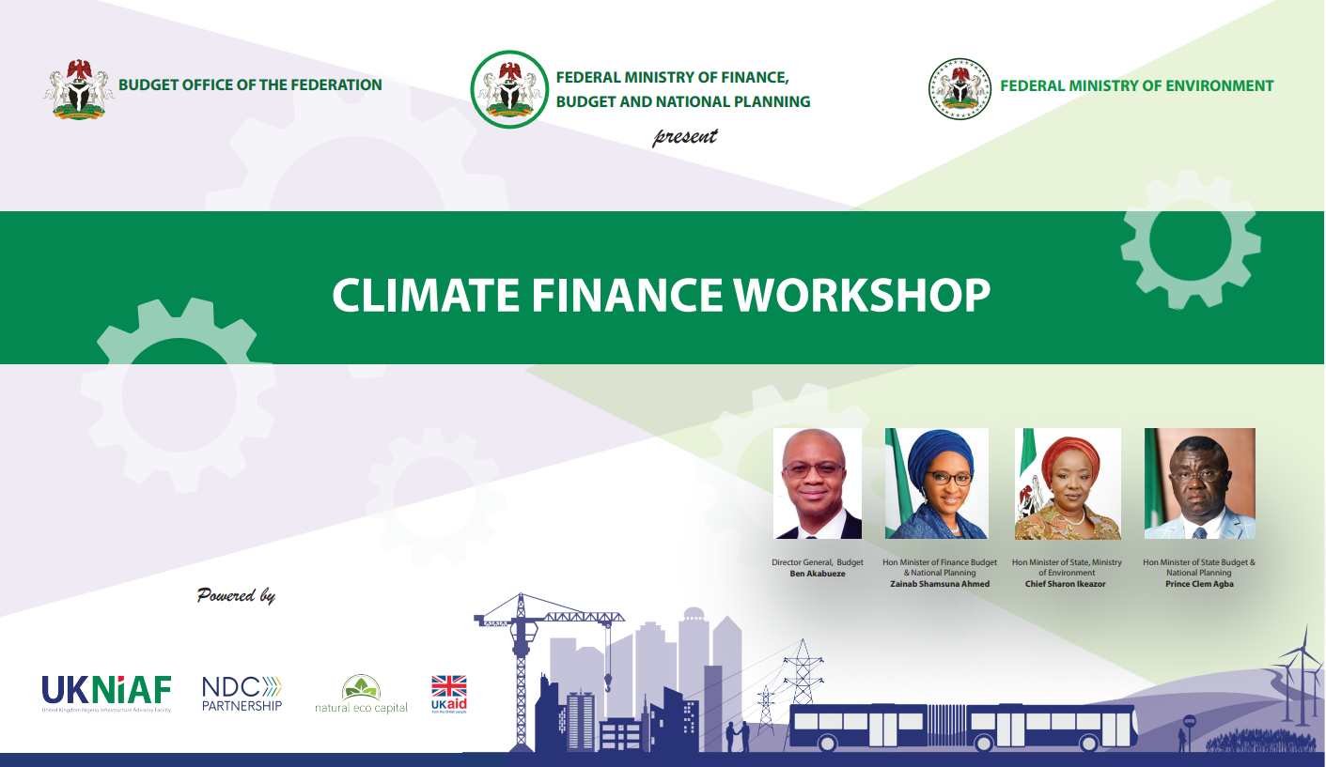

Slide 2
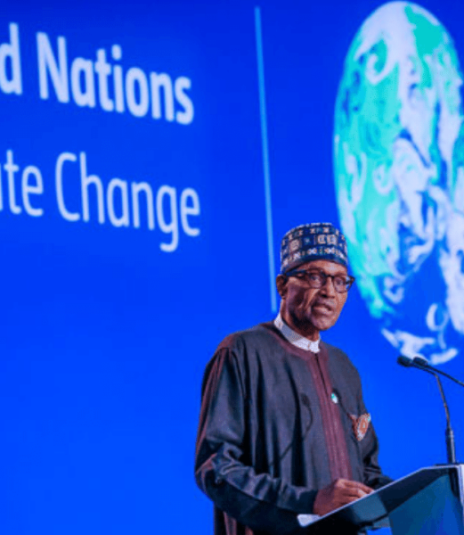
Workshop Objectives
Acquaint Ministries, Departments and Agencies (MDAs) with Nigeria’s updated National Determined Contributions, which set out the key priority actions to limit global temperature rise to less than 1.5°C.
Use relevant case studies of successful interventions to introduce and explain the concepts of climate finance.
Provide DFIs with a platform to connect and establish relationships with MDAs with existing low carbon, climate resilient infrastructure project proposals at various stages of development.
Help address the knowledge gaps that will support the transition towards the development and delivery of low carbon, climate resilient infrastructure by linking this to the achievement of Nigeria’s NDC.
Help MDAs understand the evaluation criteria that infrastructure finance provides use in assessing potential projects for finance.
Reinforce to MDAs the internationally accepted standards of project preparation infrastructure finance providers and private sector developers expect to see to increase investor confidence.

