Slide 1
Leadership, Organisation, Policy, Strategy and Risk
UKNIAF RD0011 Workshop 1
7th October 2021
Presented by:
Stephen Mead

Slide 2
Agenda
Leadership
Organisation
  Asset Manager
Policy
Strategy
  Performance Management
Risk

Slide 3
Why Asset Management?
The key reasons for adopting asset management are:
  Reduce the cost of operating the asset in a robust transparent way
  Reduce the investment capital costs
  Improve safety for stakeholders
  Reduce the risk to stakeholders both operators and users
  Deliver improvement in the performance of assets
  Deliver a robust method for measuring performance
  Deliver a sustainable and long term approach to the management of the asset
  Support carbon reduction and climate change agendas and initiatives
Notes:
And how do you do this

Slide 4


Leadership

Slide 5
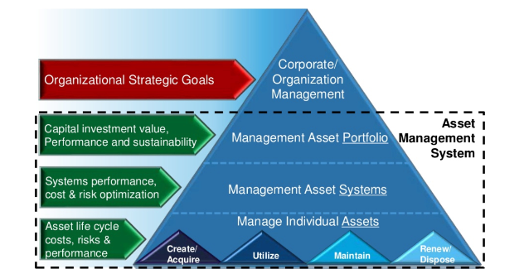
Asset Management Roles
Provides – Leadership, high-level vision, goals and objectives, direction, defines what the organisation wants to achieve
Strategic
Manage data, analyse, plan and report, use data and risk to determine the most affective maintenance and replacement of the assets, and where to concentrate finance and resources to deliver a safe and reliable network
Tactical
Organisational
Surveys, inspections, assessments, management and deployment of resources in undertaking cyclic, planned and reactive work.
Notes:
So a three pronged approach
Strategic
Tactical
Operational

Slide 6
Who does what?
Corporate – Lead and Direct
  Strategic – Direction and plan
Tactical – Analyse and plan – how, when, why, where,
  Prioritise what who
Operational – Deliver cyclic, planned and reactive maintenance

Slide 7
Leadership – what does it provide?
Direction – aims, goals and objectives of the organisation
  (political and practical balance)
Funding – financing asset maintenance and replacement
  (limited funding)
Accountability
  (but don’t forget incompetency and negligence)
Support – resources, change management, inspiration
Bridges Politics – the technical / political gap
  (the difficult decisions)

Slide 8
Leadership and the organisation
Good leadership should result in the organisation sharing
Same direction
Same aim
Same responsibility
  Leadership and the organisation are all involved in the process of getting the highway network in the best possible shape for the user
  It’s a responsibility that FERMA can’t ignore

Slide 9
The Role of Leadership In Asset Management
The single most important factor in the successful implementation of Asset Management is the buy in from Top Management and the Leadership team.
  It is important that the leadership team within an organisation has a full understanding and clear vision of how to optimise the use of its assets and gain maximum benefits across the organisation.
  It is their role to clearly articulate this vision and to communicate it in a persuasive and practical way while giving directions. This ensures organisational commitment to the longevity and evaluation of assets during the Asset’s lifecycle.

Slide 10
Leadership and the organisation
The leadership team are also tasked with making decisions with relation to the core assets of an organisation, these may well impact individuals utilising the assets as well as the performance of the organisation. Therefore they have to:
be decisive in the face of ambiguity
give confidence to stakeholders on the direction and benefits of particular assets
inspire and motivate staff to achieve the organisation’s goals
provide support
treat and trust people as individuals and teams
be trusted by the staff to consistently and regularly make the right decisions for the assets and the business.

Slide 11
How can the Leadership team demonstrate their commitment to Asset Management?
Provide clarity around the organisational objectives
Communicate the future direction of the business including the likely objectives and changes in risk appetite
Ensure employee engagement in developing most likely scenarios for future planning
Demonstrate willingness to listen to reasoned arguments about interaction between objectives and constraints
Decide what are the various stakeholders’ requirements and how these will be communicated and reported
Be clear about the businesses requirements in relation to the asset management system

Slide 12
To summarise, it’s a contract
The leadership’s ability to understand current and future demands of the business and its assets are critical to the success of not only asset management, but also the achievement of the relevant strategic objectives.
To meet this, the Asset Management team need to provide realistic options looking at cost, risk and performance.
…. and the organisation may have to change!!!

Slide 13


Changing the way we work, the way we think
Asset management is not maintenance management, it’s lifecycle management
It’s something that requires the organisation to change
Everyone has an effect on the asset
Everyone has a part to play
Everyone has a responsibility
to making the asset perform better

Slide 14
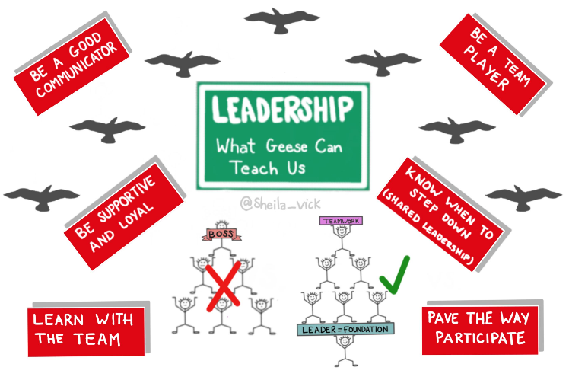
… and to change, effective leadership needs to ….

Slide 15
Let’s look at the benefits and what geese can teach us…

Slide 16

Communication
If you’ve ever seen a flock of geese flying overhead, you’ve probably noticed their unique “V” formation. It turns out, that the inherent nature of geese in flight has a lot to teach us about leadership, connection and teamwork.
  Geese flying in a V-formation and honk to encourage the geese ahead of them.
  Honking also helps them communicate their position to maintain speed

Slide 17
Working together
As each goose flaps its wings, it creates an “uplift” for the birds that follow. By flying together in one “V” formation, the whole flock adds 71% more momentum than if each bird flew alone.
  There’s power in unity when a group of people are working toward a shared goal. Great teams recognise and leverage the strengths of each individual, which enable them to accomplish much more than if they were working alone.

Slide 18
Provide support and an open dialogue
When a goose falls out of formation, it suddenly feels the drag and resistance of flying alone. It quickly recognizes this and moves back into formation to take advantage of the lifting power of the bird immediately in front of it.
  When one team member is struggling and not showing up as a team player, there’s a real risk of morale and productivity issues for the whole team. Quickly address your concerns by inviting your team member into a collaborative dialogue and revisiting the teams’ vision, values and goals. Explain how they contribute and why their role matters to the rest of the team. Find new opportunities to re-engage them.

Slide 19
Share the burden – it’s not all down to the asset manager
When the lead goose tires, it rotates back into the formation and another goose flies into the leadership point position.
  It builds trust and confidence when team members take turns doing the hard tasks and sharing leadership. Like geese, a team is interdependent on each other’s skills, capabilities and unique talents. By sharing responsibility and accountability, we develop stronger, more connected teams.

Slide 20
Encourage and value your staff
Geese flying in formation honk to encourage those up front to keep up their speed
  When’s the last time you gave a shout-out or “honk” to your team? In teams where there is consistent encouragement and recognition, productivity is much greater. The power of encouragement, i.e. to give someone support, confidence, or hope, is the quality of “honking” that creates the culture of connection every team desires.

Slide 21
Look after the staff
When a goose gets sick or wounded, two geese drop out of formation and follow it down to support, assist and protect. They stay until the goose dies or can fly again. Then, they launch a new formation or catch up with the flock.
  The very best teams mirror the instinctive behaviours of geese and stand by each other in difficult times, looking out for one another and caring deeply about each other’s well-being.

Slide 22

Get farther, together. ...
Share leadership. ...
Be encouraging. ...
Communicate. …

Slide 23
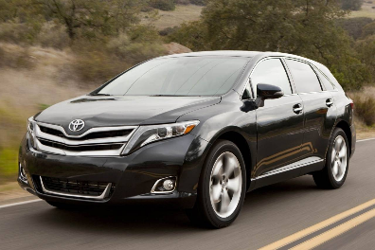

Who is an Asset Manager?
Everyone is an asset manager in one way or another
Most of us own property, cars, and money for example
Successful, honest and transparent asset management means taking a long term view of possessions
A good asset manager will own property in good condition and a car which is generally roadworthy and well serviced and ready to go

Slide 24
Who is an Asset Manager?
Everyone is an asset manager in one way or another
Most of us own property, cars, and money for example
Successful, honest and transparent asset management means taking a long term view of possessions
A good asset manager will own property in good condition and a car which is generally roadworthy and well serviced and ready to go
Asset | Actions | Benefits
House | Clean, paint, repair and monitor | Will keep the property in a safe and habitable condition
Car | Check safety, service, repair and monitor | Will keep the vehicle in a safe and serviceable condition
Aspirations/ future purchases | Consider longevity, maintenance versus cost of replacement, need, value for money | Planning for the future, minimising expenditure on maintenance, maximising longevity
Holiday | Value, benefit, cost, cost benefit analysis | Relax,, recharge & health
Life | Drink and drugs often shorten the lifecycle Fitness and healthy food tend to prolong it | Alive and healthy

Slide 25
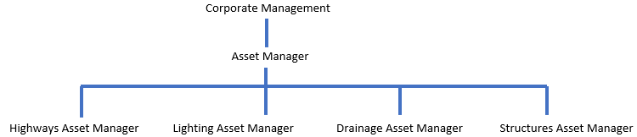
Asset managers in the organisation
Everyone who is responsible for an asset is an asset manager
  Asset manager
  Asset group manager
Is the Drainage Asset Group Manager different to the Drainage Manager, no he just needs to think differently

Slide 26
Asset manager competencies
Determine policy and strategy to achieve the aims, goals and objectives of the organisation
Understand – Data, it’s collection, update and value in decision making
Analyse – Risk, risk of asset failure, risk of short-lived maintenance solutions, risks to safety
Plan – Make use of lifecycle planning, plan for the future and what future budgets might be needed
Enable – lifecycle plans to become a plan of activities that could be developed into annual delivery plans
Report – Performance, outputs, successes
Improve - The condition and longevity of assets and maintenance and management practices by monitoring and learning (Lessons Learned)

Slide 27
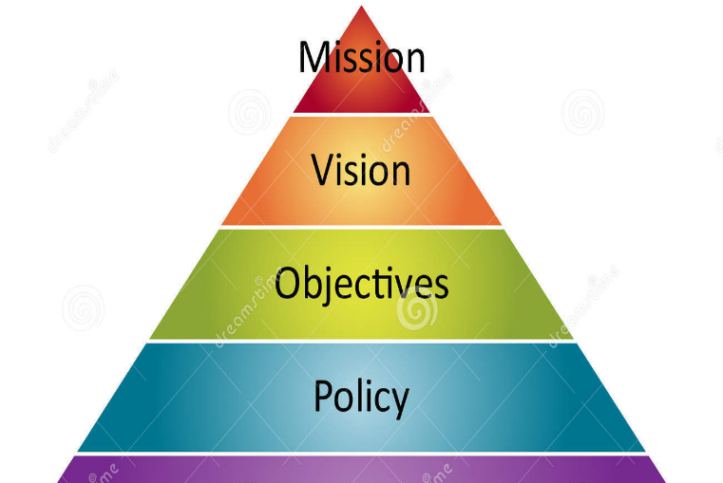
Policy and Strategy

Slide 28
An asset management framework
Asset management comprises a series of components that are interlinked and provide a process to manage an asset through its life cycle.
An asset management framework is usually a set of documents which outlines the systems and processes that have been adopted by the organisation to ensure that they have considered their responsibilities with regards to maintaining that asset.
It usually contains the following documents:
  Asset Management Policy
  Asset Management Strategy (& Asset Group Strategies)
  Asset Management Plan (5yr Asset Management Plan)

Slide 29
Asset Management Policy & Strategy
Demonstrate the commitment to adopting the principles of asset management by senior decision makers.
Document the principles, concepts and approach adopted in delivering your business
Set out the desired headline levels of service from implementing asset management.
  Safety, Reliability, availability, Sustainability
Facilitate communication with stakeholders of the approach adopted to managing highway infrastructure assets.
  Ensure the policy delivers the stakeholder needs, not just your needs
Notes:
Good Asset Management within an organisation needs policy and strategy documents
They need to be written down and stuck to
They need reviewing annually
A good start is to set down what you are doing and then improve on it
If there's no policy, no strategy then there's no direction and its difficult to defend your actions when things go wrong
Its also difficult to identify performance issues and improvements
eg – Property Management
Policy – expand portfolio
Strategy – How – refurbish, off plan, new build, p/ship
Plan – details and processes

Slide 30
Policy
An organisation’s policies and strategies define
how it will operate
the aims for delivery of its goals and objectives
Good Asset Management within an organisation needs policy and strategy documents to be recorded, adhered to and reviewed annually.
The consequences associated with not having policy and or strategy documents in place include
lack of direction
defence of actions when something goes wrong or fails
difficulty in identifying performance issues and improvements.

Slide 31
What is an asset management Policy?
A policy is a high-level statement of the organisations intent.
For example:
Government policy is a rule or principle that guides decisions that should result in positive outcomes that enhance the community.
For example – the Council recognises the importance of its local highway network in supporting the delivery of services and achieving the overarching Council vision and transport goals and is committed to applying asset management principles to the management and maintenance of its highway infrastructure”

Slide 32
Asset Management Policy
  The asset management policy is a short and concise document that describes the principles adopted in applying asset management to achieve the company’s strategic objectives
  It provides a visible commitment to achieving the benefits that can be delivered through asset management and should be established at the highest level
Ideally, it is a one or two page, stand-alone document that is readily accessible
It demonstrates the commitment by senior decision makers and should do the following:
  Make reference to the goals and objectives of the organisation
  Set out the principles, concepts and approach adopted in delivering a business using asset management
  Facilitate communication with stakeholders of the approach adopted to managing highway infrastructure assets.
Notes:
How you are going to deliver your objectives
HA example – objective to improve highways
Options
Preventative
Restorative
Improve
Could be linked to what you want to deliver to your customers

Slide 33
What is a Strategy?
A strategy is a plan of action designed to achieve a long-term or overall aim.
For example:
  a plan for moving and setting out troops for a potential battle (a strategy / strategic move)
  a specific play / tactic devised by the coach and team so as to win a football game
  a marketing strategy that might look at cost, demand, delivery, product and promotion to ensure the organisation can secure and maintain the market share for its product.
Strategies need to be coordinated across all assets and have the following attributes:
  Recognise values and use them to prioritise
  Consider the risks
  Optimise the approach
  Apply joined up thinking
  Justify and record actions
  Think long term and sustainable
  Provide for monitoring performance

Slide 34


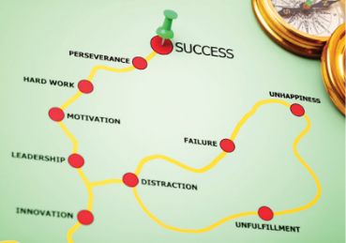

Strategy
It’s a road map

Slide 35
And it has a …
Start and a Finish
  We know the direction
  We may get diverted
Need to know how well we are doing
  Performance Management
  How far, what's its cost, efficiency (fuel consumption), time, are we on track, can we get back on track?
In asset management terms that means
  How are we doing with data collection?
  Understanding condition
  Developing lifecycle planning
  Understanding risk
  etc

Slide 36
Asset Management Strategy
Should be a clear and concise high level document setting out how asset management is delivered for the organisation to meet its long term corporate goals and objectives.
Sets a clear direction for implementation of asset management and provides a link with other relevant documents
High level plan, broken down into key elements that will require further detail about the specific process and procedures that need to be put in place.
Provides guidance to employees and an understanding of how the organisation will deliver its product for the customer and investor.
Should cover:
  The strategy for developing asset management
  The strategy each asset group to develop asset performance forward and annual plans
Notes:
And to do this you nee to include the following in your strategy

Slide 37
A strategy should
  Set out a plan – details and processes
  Define what the asset is
  State how the condition of the asset will be measured
  State the level of service of the asset (condition based)
  State what needs doing and how much it will cost to get it to the required level of service
  The process for making investment decisions and the priorities for funding
  Identification of any critical assets and management of risk associated with those, as well as all other assets
  Initiatives undertaken to improve any asset management activities
  Specific aspirations or plans and a timescale and funding strategy to achieve them

Slide 38
A good strategy makes the case for funding
Sets out what can be achieved – condition projection and scenarios
Understands the costs
Understands the risks
Requires Data (condition & inventory) – up front investment
Identifies future rewards

Slide 39
Strategic approach
Strategies may comprise one or more of the following approaches and may set out an intention to move from preventative state to improved:
  Preventative – preventing further deterioration and ensuring a safe asset
  Restorative – returning an asset to its original condition
  Improve – improving the asset and its serviceable state
Finally the strategy should set an overall time frame for delivery and set out how it will be monitored (performance management) and also how the organisation or stakeholder will know when parts of the strategy are complete.

Slide 40
Strategies for asset groups
A policy and strategy for each asset group
What it is
Why it’s important
Service level
Performance management
Funding
Method
Strategy - preservation restoration, improvement
What will the strategy deliver, and when

Slide 41
Effective policy and strategy provides
Plan
Execution
Timetable
Milestones
Outcomes
Performance measurement
Performance management
Accountability

Slide 42
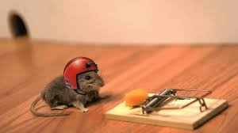
Risk
What's the risk ???

Slide 43
What Risks
Asset loss / damage
legal
human
reputation
Service reduction / failure
financial
safety
environmental
operational
social
contractual

Slide 44
Defining Risk
Risk is the chance or probability that a person will be harmed or experience an adverse health effect if exposed to a hazard. It may also apply to situations with property or equipment loss, or harmful effects on the environment.
Risk refers to an uncertainty about the effects or implications of an activity, or event potentially affecting health, well-being, wealth, property, business, or the environment, and often focuses on the resulting negative consequences
In simple terms
  Risk is the possibility of something bad happening
  Risk involves uncertainty about the effects/implications of an activity with respect to something that humans value
  Risk often focuses on negative, undesirable consequences

Slide 45
How do we feel about risk?
The fear of risk never goes away
He who risks and fails is better than he who does nothing at all
Feel the fear and do it anyway
The biggest risk is doing nothing
If you risk nothing you risk everything

Slide 46
So why is understanding risk important?
Risk concentrates our mind on where we should be putting our resources
Climber – concentrates on harness, belay points, rope knots
Car driver – concentrates on speed, road surface, bends, how relevant is the radio
Making a cup of tea – concentrates on the boiling water

Slide 47


Why take risks?
A totally risk averse organisation makes no progress
So you have to take risks to make progress

Slide 48
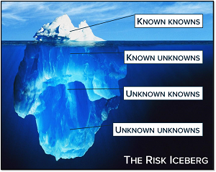
Do we understand enough to take risks?
Known knowns
  Risks known and understood to some level
Known unknowns
  Risks that are potential risks, but not yet understood
Unknown knowns
  Risks where all the necessary information is known, but the whole picture is not understood enough to take any action
Unknown unknowns
  The biggest risk as these are risks that are completely unexpected and that nothing is known about

Slide 49

How far depends on Appetite for risk
Risk appetite describes the level of risk that an organisation will take in pursuit of its goals and objectives before action is deemed necessary to reduce the risk.
It represents a balance between the potential benefits of innovation and the threats, that change inevitably brings.
"Amount and type of risk that an organisation is prepared to pursue, retain or take"

Slide 50
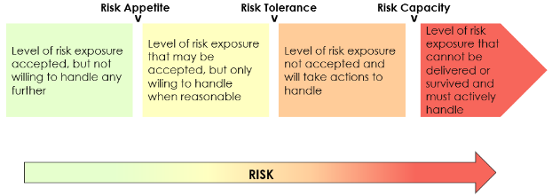
Risk tolerance and capacity
Risk tolerance reflects the level of returns that an organisation is willing to withstand in their planning, its an important component to consider and those individuals or organisations with a higher net worth and more disposable income may afford to take greater risks.
Risk capacity is the amount of risk that the individual or organisation can afford to take to reach their goals and objectives and should be balanced against the rate of return.

Slide 51
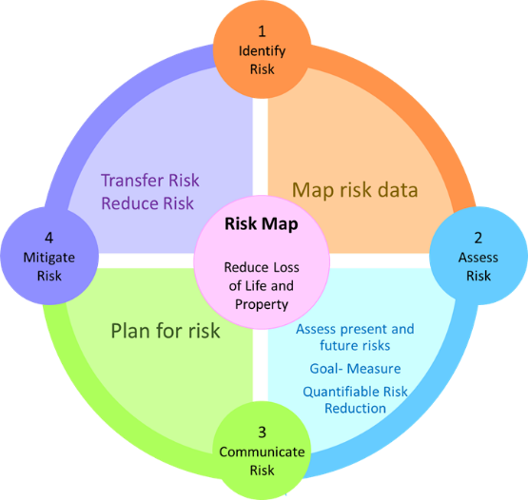
Mapping risk
Identify
Map
Assess
Communicate
Mitigate
Can we plan for risk – Risk Assessments

Slide 52
Using a Risk Register
Individual risks should be identified and included within a Risk Register comprising all risks likely to affect the assets or delivery of the organisation’s goals and objectives.
Risk registers provide the opportunity for those risks associated with the assets maintenance and management to be identified. These may be corporate, tactical, or operational, and ensuring risks are referenced in this way assists in clarifying ownership of how these risks will be managed in the future.
For example, one of the common risks arising in the maintenance of the highway infrastructure assets is a lack of funding for staff and resources to deliver effective asset management. Whilst this affects the tactical and operational areas of the service the provision of funding is a corporate issue and as a consequence should be referred to the corporate level for resolution. An example of a risk register can be found in figure 11 and illustrates the level of detail that can be recorded against an asset.

Slide 53
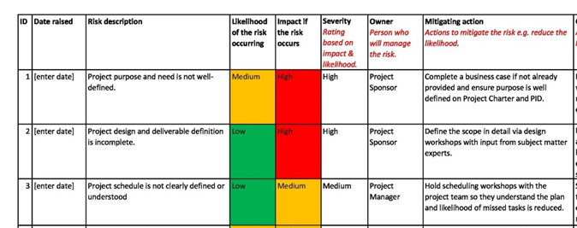
Identify Risk - Simple

Slide 54
Identify Risk – add a risk score

Slide 55
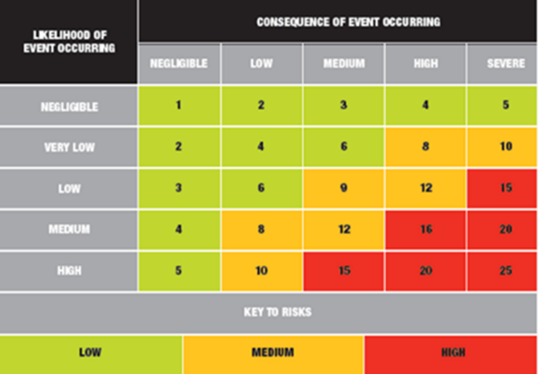
Assessing and scoring risk
Severe
High
Medium
Low
Negligible

Slide 56
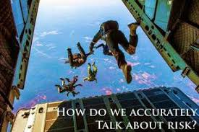
Communicate Risk
Who do we tell?
When do we tell them?
How do we tell them?
Why do we tell them?
What do we tell them?
Where do we tell them?

Slide 57
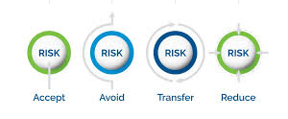
Mitigating risk
Transfer
Program
Manage
Live with
Terminate
Tolerate / accept
Mitigate / reduce
Response | Which means?
Tolerate | Do nothing ‘extra’ to manage the risk.
Treat | Mitigating the risk by managing either: the likelihood the impact or both
Transfer | Insurance/ outsourcing/ partnerships
Terminate | Stop doing a activity

Slide 58
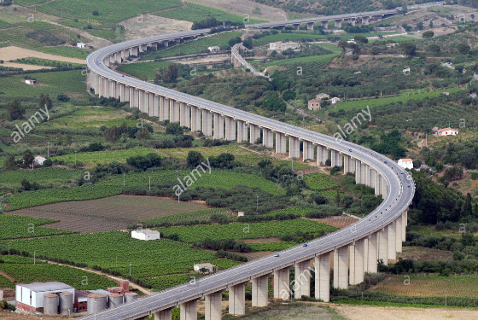
Where can we take risks?
Where we can afford to, perhaps
Low flow roads – less traffic
Low speed roads – less speed
Non essential elements of the network
Where mitigating measures are in place
  Speed reduction
  Single flow

Slide 59
How can we use risk?
To identify where areas of the organisation or the infrastructure network are vulnerable
  Risk Register - Action plan and address
To prioritise works from a forward works plan
  High risk – action required
  Low risk – defer / no action

Slide 60
Encouraging the use of risk - UK Road Funding
Road Funding does not meet the maintenance need based on a planned lifecycle approach
However the UK Dept of Transport won’t fully fund maintenance as it stifles
  Innovation
  Using a risk based approach
  Improving efficiency

Slide 61
… and don’t forget, the purpose of asset management is to reduce risk
… and we’re better at doing that if we understand
What we have
The condition it’s in
The service lives
The costs
And can produce a lifecycle plan / condition projection model
Determine a forward plan
Use risk to prioritise the most effective annual service plan

Slide 62
Next steps
Reflect on the asset management principles discussed today
  Are there initiatives/topics FERMA is already working on/towards?
  What are priorities for FERMA?
  Is there a strategy in place for the development of asset management in FERMA?
  Where can UKNIAF support be best targeted?
Invitation for the next workshop will be sent out in due course.
Next workshop will cover:
  Road Hierarchy
  Data
  Data collection methods
  Data management

Slide 63
Leadership, Organisation, Policy, Strategy and Risk
UKNIAF RD0011 Workshop 1
Presented by:
Stephen Mead
Thank you for your presence

