Slide 1
Climate Finance Workshop
Technical Session 2:
Project Prioritisation & the Climate Finance Database
Presented by:
NDC Partnership and UKNIAF - IF0011 TO TEAM
29 Nov 2021

Slide 2
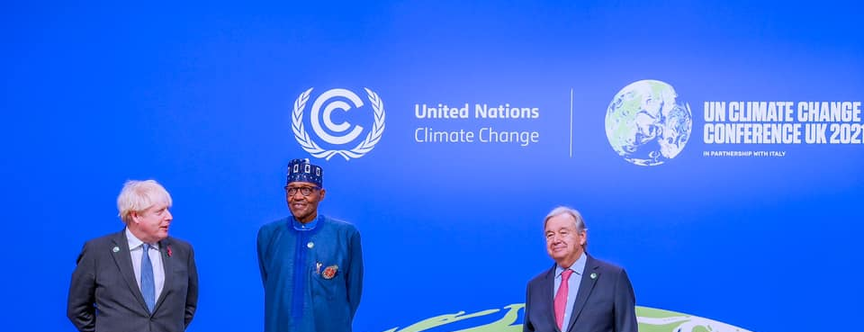
Contents
01.
Overview –
Project Prioritization, NDP 2021-25
02.
DST –
Principles, Approach & Identified Projects from 2022 Budget Submission
03.
Conclusion –
Next Steps, Q1 2022 Capacity Building

Slide 3
Contents
01.
Overview –
Project Prioritization, NDP 2021-25
02.
DST –
Principles, Approach & Identified Projects from 2022 Budget Submission
03.
Conclusion –
Next Steps, Q1 2022 Capacity Building

Slide 4

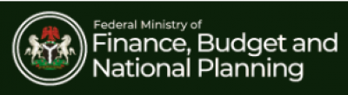
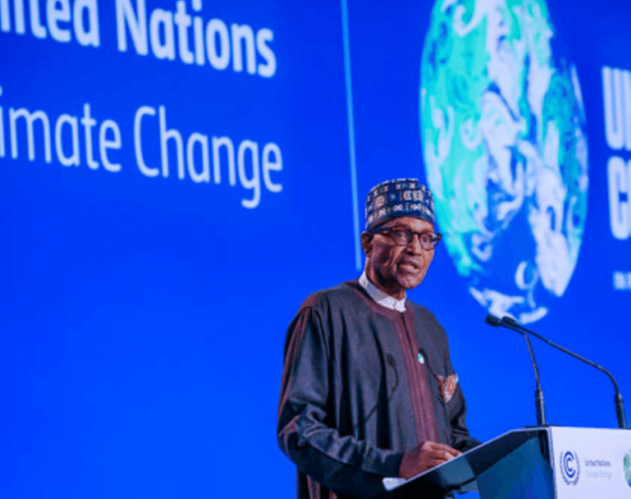
Presidential Directive
“In 2022, Government will further strengthen the frameworks for concessions and public private partnerships (PPPs). Capital projects that are good candidates for PPP by their nature will be developed for private sector participation. We will also explore available opportunities in the existing ecosystem of green finance including the implementation of our Sovereign Green Bond Programme and leveraging debt-for-climate swap mechanisms”
- President Muhammadu Buhari, GCFR
2022 Budget Speech.

Slide 5
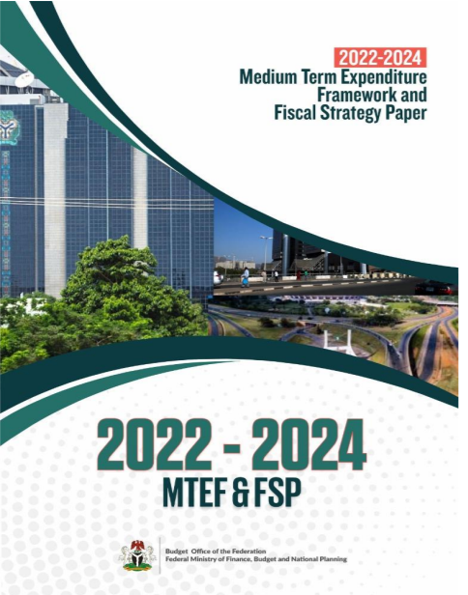
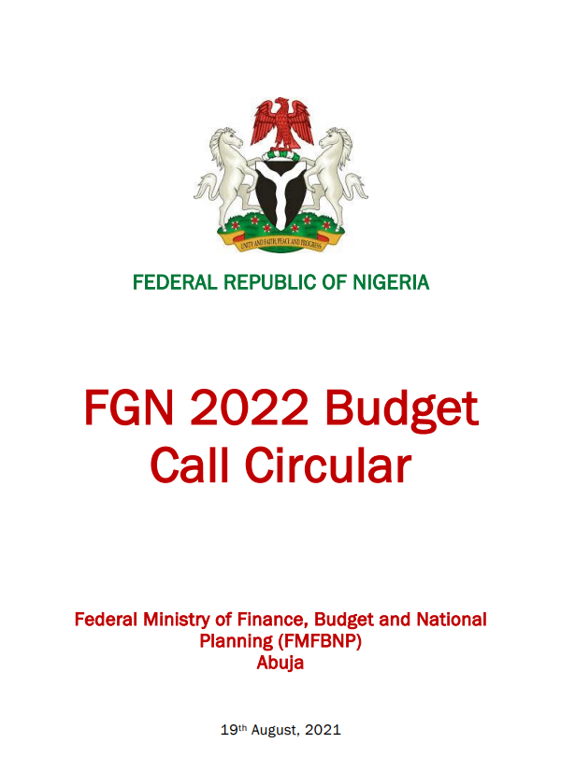
Policy Statements & FGN Strategic Priorities
Thematic Areas
1
Climate Smart Project Identification (Section 4.5.5)
2022-24 MTEF/FSP
Section 7.2.2
Nigeria is very vulnerable to climate change. However, existing infrastructure has largely not been designed to be climate smart. To address climate risks and integrate mitigation and adaptation measures in the implementation of Nigeria’s capital investment programme, government will entrench the prioritisation and selection of climate-smart infrastructure projects in the medium term.
MDAs are encouraged to develop climate smart projects with a view towards developing a database that serves as a repository and investment portal for attracting climate finance globally
2
Green Bonds & Climate Finance Funds (Section 4.5.5)
Projects must satisfy environmental objectives such as: a. Climate Change Mitigation (e.g., emission reduction) b. Climate Change Adaptation c. Natural Resource Conservation; d. Biodiversity Conservation, and e. Pollution Prevention and Control
3
Public Investment Management Guidelines
Section 3 of the Public Investment Guidelines (PIM) also reinforces the provisions of the 2022BCC and the procedures to follow for climate smart investments.

Slide 6
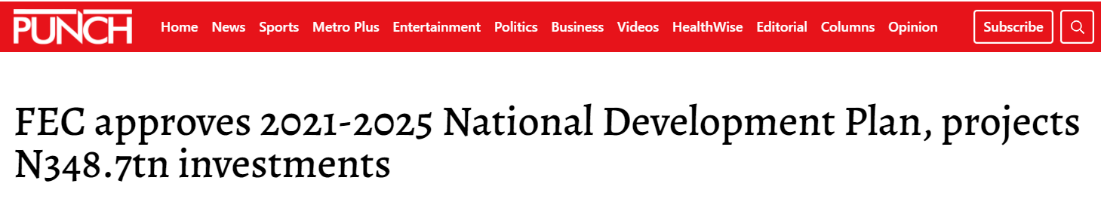
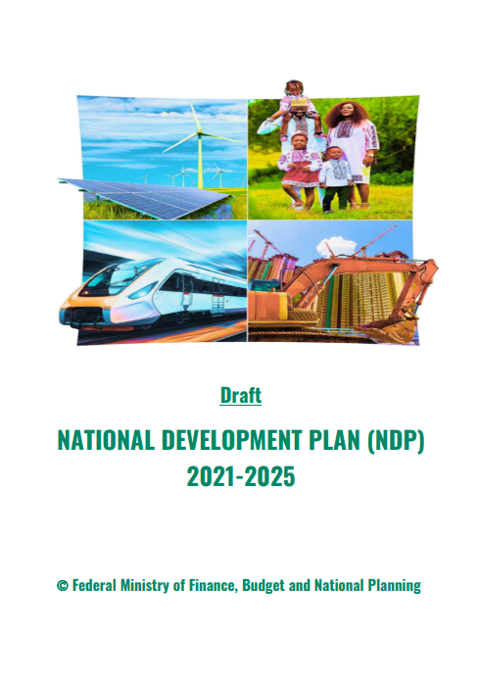

The NDP 2021-25
Thematic Areas
1
Key Policy Action - Infrastructure
Prioritization and implementation of critical and strategic infrastructure projects that will directly boost production and productivity
The plan, with an investment size of N348.7tn, will be funded by the federal, state governments and the private sector.
For the investment size above, the expected financing contribution is shown below -
  Public Sector: N49.7 tn
  Private Sector: N298.3 tn
It is there imperative to understand the importance of the conversation here today.
2
Green Economy
Nigeria will move towards climate adaptation by diversifying its energy sources away from fossil fuels and embracing the green economy to create new and sustainable economic activities
3
Protecting the Environment
Develop a Nigerian circular economy and environmental protection programme to reduce the footprint of mine waste and create new job opportunities

Slide 7
Project Screening & Prioritization
Nigeria’s capital investment requirements by far exceed available financial resources. The Government (FGN & Subnational governments), are expected to spend a combined N49.7tn between 2021-25, whereas; the total amount needed is in excess of N348tn
It is therefore clear, that available funds need to be allocated to projects likely to deliver maximum benefits relative to their costs.
Projects that are potential candidates for PPP arrangements should also be developed with bankable business cases. Similarly, projects that can attract climate finance should also be carefully screened and where viable be put forward for climate finance.
Overall, the FGN needs to improve the link between spending and policy objectives over the medium term
To this end, following the approval of the NDP 2021-25, project selection and prioritization will be such that there is a direct link between FGN overarching objectives as well as its annual budgets,
While alternate financing arrangements will be explored to be able to achieve the targets of the plan

Slide 8
Previous Prioritization Arrangements
  Over the last few years, FGN Projects selected should reflect FGN priorities
    - infrastructure, governance, social development, real economy, regional integration, environment etc as well as other execution priorities of the ERGP era
Projects usually also reflect FGN sectoral and regional objectives
Infrastructure finance institutions appreciate evidence-based infrastructure decision-making
Prioritized project pipelines improve chances of bank financing
The FGN adopted the Muti-Criteria Analysis (MCA) approach to Project screening & prioritization in the past.
MCA framework improves on previous capital project prioritization method
  It links projects to national policy objectives (as contained in any given national development plan)
  Allows use of wide range of criteria for achieving different aspects of policy objectives
  Supplements usual economic and financial indicators with social and environmental factors
  Results can be displayed graphically
  Helpful in balancing sectoral and geopolitical investment needs
  Aids quick consensus and decision making

Slide 9
Prioritization Illustration – Buying a Car
Weighting of raw scores allows specified priorities to be reflected:

Slide 10
Prioritization Illustration – Buying a Car
Raw Benefits
Weighted Benefits
Value for Money
Preferred Choice
BMW
Toyota
Toyota
Kia

Slide 11
Contents
01.
Overview –
Project Prioritization, NDP 2021-25
02.
DST –
Principles, Approach & Identified Projects from 2022 Budget Submission
03.
Conclusion –
Next Steps, Q1 2022 Capacity Building

Slide 12
Decision Support Tool (DST) Objectives
Link National Development Priorities with the Capital Budget.
Identify infrastructure projects that can contribute towards climate change mitigation or adaptation.
Align Development Priorities with NDCs
Make the case for project preparation and/or implementation assistance.
Bridge National Budget deficit.

Slide 13
Application of the Decision Support Tool (DST) Framework
The framework will help the government to make the case for receiving project preparation assistance for projects with PGESI & CC development impact.
Mainstream NDCs
into MTNDP
Project
Identification & Selection
Preliminary Analysis
CC & PGESI Assessment
Mainstream NDCs into the MTNDP and use as a basis for identifying and selecting projects to be screened for inclusion into the Annual Budget.
Review MDA submissions to identify and select projects that align with / can contribute to the achievement of MTNDP priorities and NDC targets.
Screen initial pipeline against objective selection criteria to assess the commercial requirements of potential investments and identify potentially bankable projects.
Conduct high-level assessment of CC and PGESI gaps that will be addressed during project preparation.
Climate Finance Database
Boost visibility for project preparation and implementation assistance.
List of priority sectors / themes
Initial Pipeline of Eligible Projects
Pipeline of Priority Projects
Project Vulnerability Risk Matrix
OUTPUT
UKNIAF Technical Assistance Support up to this stage including application of the DST Framework

Slide 14
Application of the Decision Support Tool (DST) Framework
The framework will help the government to make the case for receiving project preparation assistance for projects with PGESI & CC development impact.
Mainstream NDCs
into MTNDP
Project Selection
Preliminary Analysis
CC & PGESI Assessment
Mainstream NDCs into the MTNDP and use as a basis for identifying and selecting projects to be screened for inclusion into the Annual Budget.
Review MDA submissions to identify and select projects that align with / can contribute to the achievement of MTNDP priorities and NDC targets.
Screen initial pipeline against objective selection criteria to assess the commercial requirements of potential investments and identify potentially bankable projects.
Conduct high-level assessment of CC and PGESI gaps that will be addressed during project preparation.
Climate Finance Database
Boost visibility for project preparation and implementation assistance.
List of priority sectors / themes
Initial Pipeline of Eligible Projects
Pipeline of Priority Projects
Project Vulnerability Risk Matrix
OUTPUT
UKNIAF Technical Assistance Support up to this stage including application of the DST Framework

Slide 15
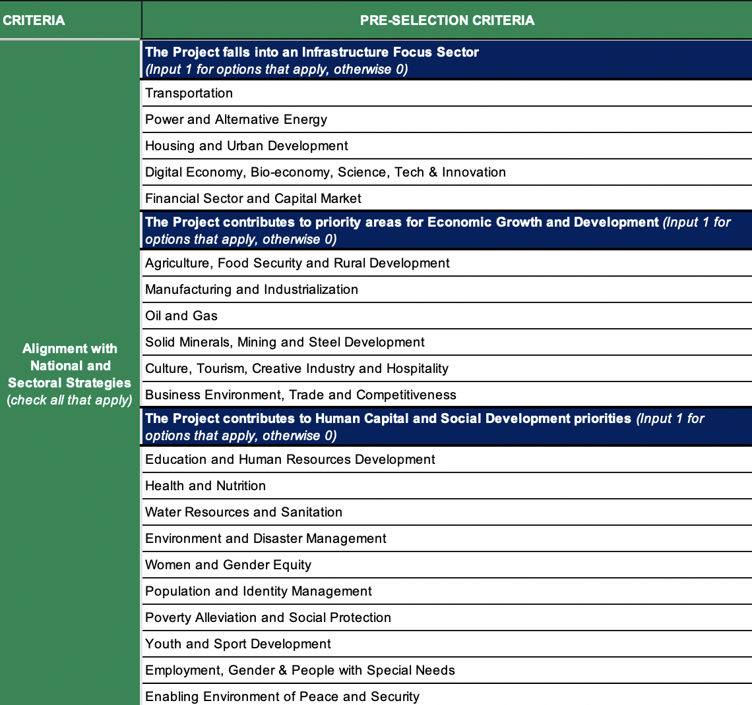
Application of the Decision Support Tool (DST) Framework
Mainstream NDCs
into MTNDP
Mainstream NDCs into the MTNDP and use as a basis for identifying and selecting projects to be screened for inclusion into the Annual Budget.
List of priority sectors / themes

Slide 16
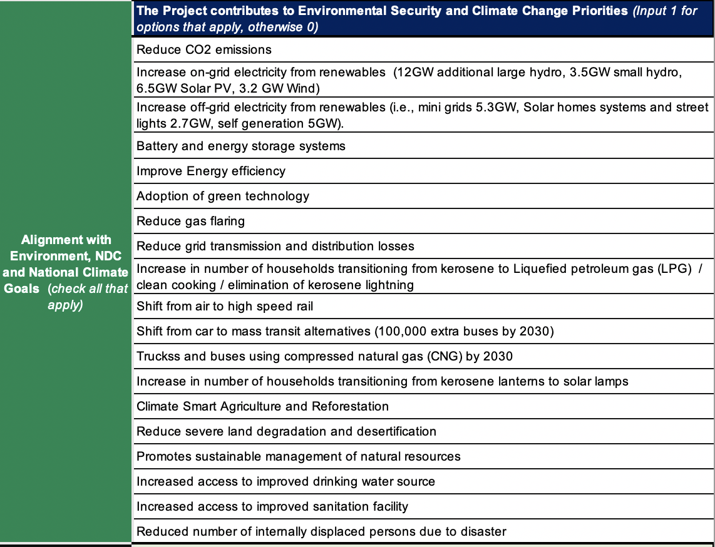
Application of the Decision Support Tool (DST) Framework
Mainstream NDCs
into MTNDP
Mainstream NDCs into the MTNDP and use as a basis for identifying and selecting projects to be screened for inclusion into the Annual Budget.
List of priority sectors / themes

Slide 17
Application of the Decision Support Tool (DST) Framework
The framework will help the government to make the case for receiving project preparation assistance for projects with PGESI & CC development impact.
Mainstream NDCs
into MTNDP
Project Selection
Preliminary Analysis
CC & PGESI Assessment
Mainstream NDCs into the MTNDP and use as a basis for identifying and selecting projects to be screened for inclusion into the Annual Budget.
Build MDA capacity to identify and select projects that align with / can contribute to the achievement of MTNDP priorities and NDC targets.
Screen initial pipeline against objective selection criteria to assess the commercial requirements of potential investments and identify potentially bankable projects.
Conduct high-level assessment of CC and PGESI gaps that will be addressed during project preparation.
Climate Finance Database
Boost visibility for project preparation and implementation assistance.
List of priority sectors / themes
Initial Pipeline of Eligible Projects
Pipeline of Priority Projects
Project Vulnerability Risk Matrix
OUTPUT
UKNIAF Technical Assistance Support up to this stage including application of the DST Framework

Slide 18
Application of the Decision Support Tool (DST) Framework
The framework will help the government to make the case for receiving project preparation assistance for projects with PGESI & CC development impact.
Mainstream NDCs
into MTNDP
Project Selection
Preliminary Analysis
CC & PGESI Assessment
Mainstream NDCs into the MTNDP and use as a basis for identifying and selecting projects to be screened for inclusion into the Annual Budget.
Build MDA capacity to identify and select projects that align with / can contribute to the achievement of MTNDP priorities and NDC targets.
Screen initial pipeline against objective selection criteria to assess the commercial requirements of potential investments and identify potentially bankable projects.
Conduct high-level assessment of CC and PGESI gaps that will be addressed during project preparation.
Climate Finance Database
Boost visibility for project preparation and implementation assistance.
List of priority sectors / themes
Initial Pipeline of Eligible Projects
Pipeline of Priority Projects
Project Vulnerability Risk Matrix
OUTPUT
UKNIAF Technical Assistance Support up to this stage including application of the DST Framework

Slide 19
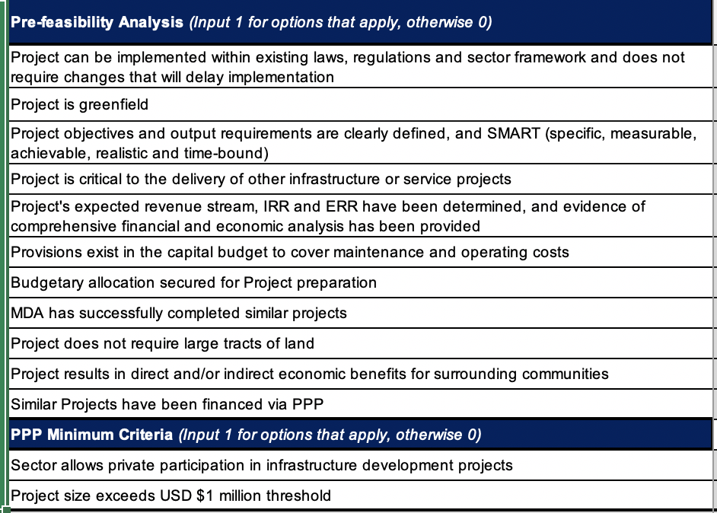
Application of the Decision Support Tool (DST) Framework
Preliminary Analysis
Screen initial pipeline against objective selection criteria to assess the commercial requirements of potential investments and identify potentially bankable projects.
Pipeline of Priority Projects

Slide 20
Application of the Decision Support Tool (DST) Framework
The framework will help the government to make the case for receiving project preparation assistance for projects with PGESI & CC development impact.
Mainstream NDCs
into MTNDP
Project Selection
Preliminary Analysis
CC & PGESI Assessment
Mainstream NDCs into the MTNDP and use as a basis for identifying and selecting projects to be screened for inclusion into the Annual Budget.
Build MDA capacity to identify and select projects that align with / can contribute to the achievement of MTNDP priorities and NDC targets.
Screen initial pipeline against objective selection criteria to assess the commercial requirements of potential investments and identify potentially bankable projects.
Conduct high-level assessment of CC and PGESI gaps that will be addressed during project preparation.
Climate Finance Database
Boost visibility for project preparation and implementation assistance.
List of priority sectors / themes
Initial Pipeline of Eligible Projects
Pipeline of Priority Projects
Project Vulnerability Risk Matrix
OUTPUT
UKNIAF Technical Assistance Support up to this stage including application of the DST Framework

Slide 21
Contents
01.
Overview –
Project Prioritization, NDP 2021-25
02.
DST –
Principles, Approach & Identified Projects from 2022 Budget Submission
03.
Conclusion –
Next Steps, Q1 2022 Capacity Building

Slide 22
Key Considerations
Capital planning that involves first identifying desired project outcomes (in the public sector, the particular focus would be on benefits to citizens) and then allocating the capital budget based on these priorities is now mandatory given the shrinking fiscal space
Nigeria has now developed new national plans, but it must ensure that every Naira spent is linked to these development plans and represents value for money
A tailored approach to project selection and prioritization and how projects are funded is a must
A strategic focus is now required as private finance is required to close the capital investment deficit
Budgeting for infrastructure needs to transition from initial capex to whole-life costing of infrastructure
Budgets must be adequately monitored, and ultimately, budget performance evaluated

Slide 23
Conclusion
Federal budget processes need to be better equipped to prioritise project selection against growth objectives, In addition a sound budget should have M&E capability to track implementation progress of approved projects prior to release of capital allocations.
Key considerations need to be made for how and which projects are selected and prioritised, which are funded by government allocation, which are made available for private financing
To improve capital planning, public-sector agencies need to review entrenched systems for setting priorities, evaluating projects, allocating portfolio investments, and learning from past projects. Through this transformation, agencies may discover untapped potential for savings and better ways to deliver the outcomes that matter most for citizens.

Slide 24
Next Steps
Activities
Support the Budget Office to review and finalise the decision support tool (DST) with inputs from MDAs
Finalise the Climate Finance Database (CFD) to include pipeline of Climate smart infrastructure projects, Climate finance providers, and training.
Build MDA capacity to use the DST and CFD through workshops and training materials and resources
Deliver webinars on Climate Finance Database to relevant public and private sector players.
Establish the high-level framework and capacity development approach for transition of management of the Climate finance database to host MDA(s).

Slide 25

