Slide 1
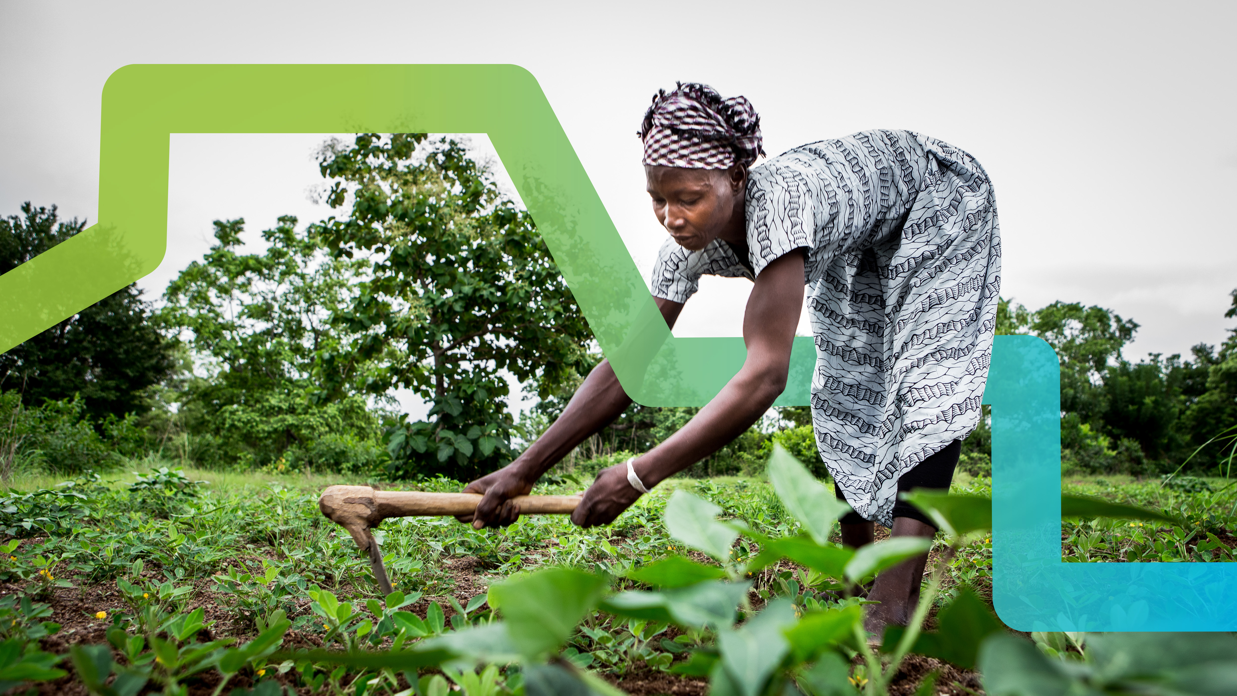

Why Green Bonds Matter in Africa
Victor Nkiiri
Senior Capital Markets Specialist
Climate Finance Workshop, Nigeria
08 Dec 2021

Slide 2
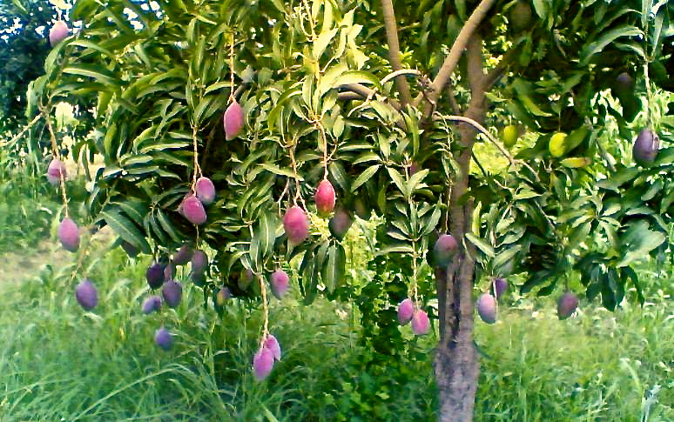
Climate Change – Opportunities for Africa
‘If your vision is for a year
plant wheat, if your vision
is for a decade plant trees,
and if your vision is for a
lifetime plant people ’
African Proverb

Slide 3

Climate Finance
Limiting global warming to 1.5°C requires rapid and far-reaching transitions in energy, land, urban and infrastructure (including transport and buildings), and industrial systems.
OECD estimates annual investment needs of US$6.9 trillion up to 2030 to meet climate objectives.
Requires mobilization of private and public funds.
Government policies that reduce the risk of climate-friendly investments and the mobilization of private funds.
The bond markets through Green, Social and Sustainability Bonds can play an essential role in attracting private capital for climate finance.

Slide 4

Green Finance Trends: Global and African, Today and Tomorrow
Opportunity
SSA governments have limited fiscal space. Their economies are not expected to recover their recent Covid losses for five years. The funding gap (2020-23) is estimated at $410bn.
Crowding in private finance from international and domestic sources is a necessity, not a nice to have...
Green economy can deliver faster, better quality growth (UNEP)
Global financial industry is undergoing a transformation to decarbonise – reducing its exposure to assets that carry climate risk and actively increasing investment towards green projects.
Climate change presents a US$ 3 trillion investment opportunity in Africa by 2030 with 75% of the investment expected from the private sector.
Over 60% of NDCs of African countries are subject to available finance, capacity and technology transfer.
$60 trillion
Required to achieve the Paris Agreement from now until 2050
$1.2 trillion
Required annually for mitigation
$180 billion
Required annually for adaptation
56%
Of climate finance is private finance
2.6%
Climate finance invested in SSA (2015/2016) ($270b)
Notes:
¹ https://sdgcafrica.org/wp-content/uploads/2017/03/sdg-financing-for-africa_key-propositions-and-areas-of-engagement-.pdf
² https://irena.org/newsroom/articles/2020/Mar/The-Investment-Case-for-Energy-Transition-in-Africa#:~:text=IRENA%20estimates%20that%20Africa%20requires,as%20improved%20healthcare%20and%20education
³ https://www.afdb.org/fileadmin/uploads/afdb/Documents/Project-and-Operations/Cost%20of%20Adaptation%20in%20Africa.pdf
⁴ https://www.paulsoninstitute.org/wp-content/uploads/2020/10/FINANCING-NATURE_Full-Report_Final-with-endorsements_101420.pdf
⁵ https://www.files.ethz.ch/isn/164236/SitRep2013_6May.pdf
6 https://www.afdb.org/en/news-and-events/article/bank-group-doubles-portfolio-to-usd-15-6-billion-in-4-years-6896?page=38
7 https://wedocs.unep.org/bitstream/handle/20.500.11822/30619/AMCEN_17_7.pdf?sequence=1&isAllowed=y

Slide 5
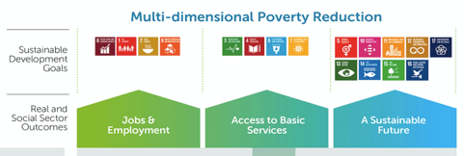
Capital Markets: Overall Theory of Change
Increased access to finance to public & private sector
e.g infra, housing, corporate sectors
Resilience to financial shocks and support for macroeconomic stability i.e reduced likelihood & impact of financial crisis
Environmental sustainability
i.e greater resilience & carbon-neutral growth
Deeper and more efficient domestic capital markets i.e reduced cost of capital
Financial Sector Diversification i.e reducing dependency on banks
Reduced currency risk improving stability and creditworthiness
Reduced refinancing risk improving stability and creditworthiness
Increased financing directed to climate adaptation and mitigation projects
TOC
Domestic Capital Markets
TOC
Local Currency Finance
TOC
Green and Sustainable Bonds
Capital markets remain underdeveloped in Africa, limiting access to finance and undermining economic development.

Slide 6
The market system
SUPPORTING
FUNCTIONS
MARKET PLAYERS
Information
Infrastructure
Informing & communicating
Related
services
Private sector
Government
The cause of poor performance here .....
.... lies here
Demand
Supply
CORE
Regulations
Setting & enforcing rules
Informal rules & norms
Business membership organisations
Informal
networks
Standards
Laws
RULES
Not-for-profit sector

Slide 7
Example of a market system (capital market)
Enabling structures/functions
Private Sector
Capital Markets infrastructures
Co-ordination of capital markets
Capital Markets research & analysis
Capital markets credit ratings
Capital markets skills and capacities
Capital markets instruments
Government
Securities indexes
Informing and communicating
Supply
(of long term capital)
Demand
(for long term capital)
Capital Market
Informal networks
International investors
Domestic investors
DFIs
Debt markets
Investment ready projects and firms
Governments
International development partners
Equity markets
Setting and enforcing rules
Capital markets legal frameworks
Investor protection
Capital markets regulations
Corporate governance criteria
Lasting rules
Capital markets norms and standards
Regulations
Representative bodies
Rules

Slide 8



How we work- Green Bond Programme
Policy/Regulation
Policy development promotes financial stability and resilience of the financial sector. It promotes better collaboration and sustainable product development.
Market Infrastructure
A developed capital market infrastructure provides incentives for innovative product development and access to inclusive capital by market actors who demand capital.
Market Actors
Well-developed market infrastructure is critical to the efficient functioning market and allows well-capacitated market actors to participate actively in the market.
Approach to market is critical for all interventions. Understanding the market interdependencies and components. We work with them in parallel to ensure efficiency and success

Slide 9
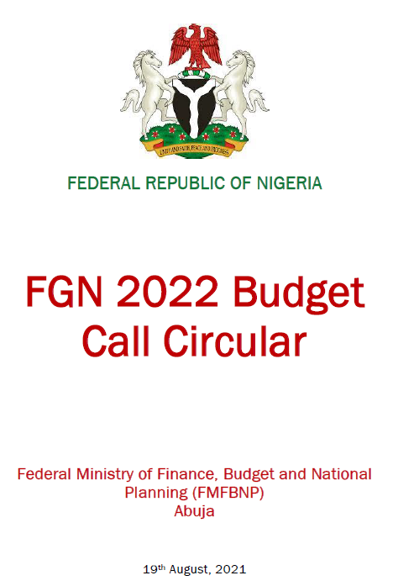
Policy and Regulation
We play a unique role in driving sustainable policy development that will facilitate the growth of green bond issuance.
Market Fragmentation
Clear guidance to the ministries- Eligibility criteria for climate-smart infrastructure projects
Enhances collaboration between the MDA’s
Clear pipeline development for the green bonds
Sustainable borrowing programme over the years and demand for the green bonds
Invites foreign investors to the market

Slide 10
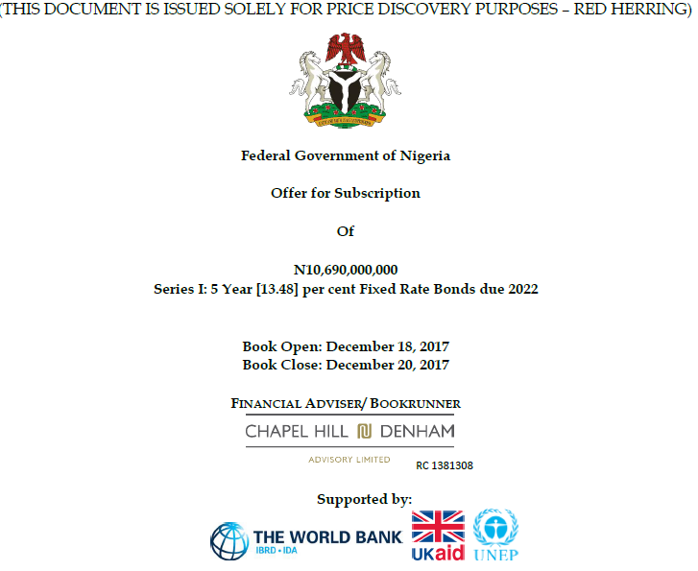
Market Infrastructure
We work together with our local partners to ensure the availability of a range of services that support governments, investors and financial institutions are in place to contribute to economic growth.
Innovation
Innovation- 1st Green bond in Africa (Pre & Post Issuance verification).
Promoting access to inclusive capital
Fostering risk-taking and long-term investments. Longer-dated bonds
Capital flow fluctuation
Private capital

Slide 11
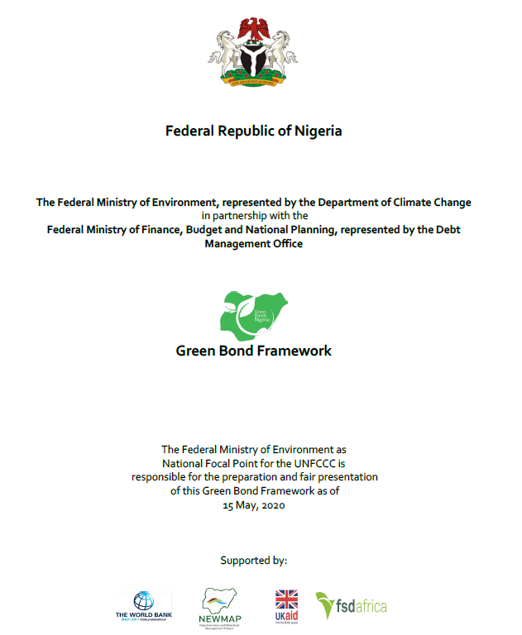
Market Actors
Our technical assistance facility catalyses market actors through capacity enhancement and knowledge transfer to ensure sustainability in the issuance of Green Bond.
Demonstration
Capacity building
Diversification
Collaboration

Slide 12

FSD Africa Green Bonds Programmes
The path to 2050 and the Africa we want
Demand-led foot-print. We have mobilized US$200 million through green bonds in Nigeria and Kenya
Morocco
Green bonds transactions
Rwanda
Transactions support, policy
Regional
Climate finance training – CISL/IIED/ESAMI
IOSCO - AMERC sustainable finance support
SADC Green bonds programme (16 countries)
Africa Green Finance Coalition
Task-Force for Nature-related Financial Disclosures
WAEMU
Green bonds pipeline
Scoping (8 countries)
Kenya
Kenya sovereign green bond
Payment for Ecological Services
Kenya Green Bonds Programme - transactions support
Support to Climate Finance Unit
Universities Solar Financing Project
Green Fiscal incentives Policy
Ghana
Green bonds scoping
GSE Green listing requirements
Nigeria
Green bonds programme
Regulations and transactions – 6 transactions supported to date
Malawi
Green bond transaction support

Slide 13


Attraction of Green Bonds
Balance financial returns with environmental benefits
Improves investor diversification
Satisfies Environment, Social and Governance (ESG) requirements and green investment mandate
Lower cost of capital – oversubscriptions may tighten yields
Risk management – enable hedging against climate policy risk/stranded assets
Investor engagement & “stickiness” - typically green bond Investors invest for the long term
Investors
Issuers
Reputational benefits
Improves transparency and enables deeper engagement with company management
Reputational benefits – showing leadership on sustainability

Slide 14
Merits of Green Bonds
Alternative pools of capital
Flexibility & Accessibility
Credit & Investment Profile
Poverty
Inequalities
Green economy
Over 50% of Nigeria population live in poverty and food comprises about three-quarters of consumption basket (NBS).
Increasing inequalities in terms of access to opportunities and low social cohesion. Regional economic imbalances
Challenge of transitioning away form environmental degradation
Access to lager mix of capital from pension funds, insurance companies and HNWI
Access to long-term funds and the presence of an active debt market through FMDQ
Stakeholders perceive better governance and management, access to a broader range of lenders/investors

Slide 15
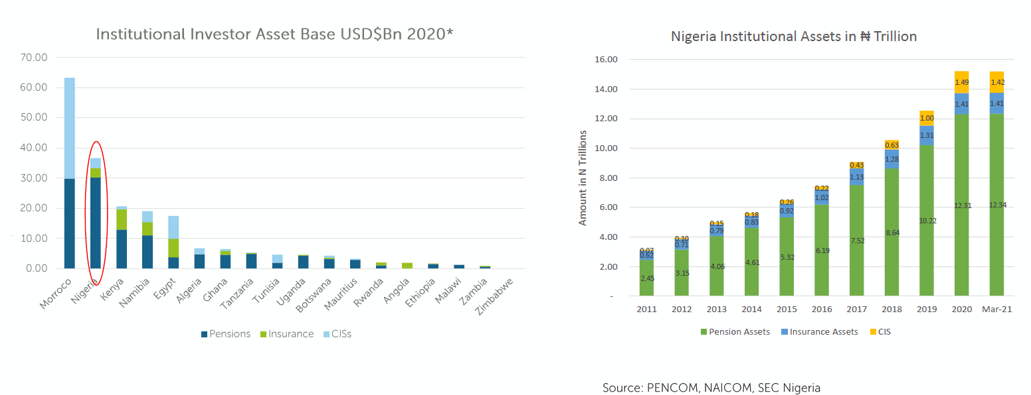
Investor Base

Slide 16
Some Issues with Green Bonds
Risks
Risk of green washing – i.e. concerns around refinancing
Certification – not equivalent to credit quality
Complex impact reporting – can also be costly particularly for DIBs & SIBs
Reporting
Lack of standardization in the reporting process
Market Awareness
Lack of awareness – investors, issuers, intermediaries and regulators
Costs to Issuers
Cost of verification/certification
Pricing – increased demand not fully reflected in the pricing of issues
Time – verification process imposes additional time to issue
Small size (non-benchmark) issues – secondary market implications
Requirements
Additional disclosure requirements to conventional bond issues
Large array of standards and rating tools – can confuse issuers & investors
Inconsistence on transitional investments i.e. clean coal (China) gas (Nigeria)

Slide 17





Green Bonds Programme Nigeria
The Nigeria Green Bond Program (NGBP) is focusing on building an ecosystem for green bonds in Nigeria:
Developing issuance guidelines and listing requirements for Green Bonds in Nigeria (issued by SEC Nigeria)
Developing a pool of Nigeria-based licensed verifiers (training done)
Developing a pipeline of green investments and engaging with investors (4 issues: Access Bank, NS Power, OneWattSolar)
Developing a debt capital market reform agenda that would support green bonds (FMDQ Green Exchange)
NGBP also supported the certification process for the Nigerian Sovereign Green Bond – the first globally

Slide 18
Thank you
FSD AFRICA PRESENTATION

